Slide 1
Vision Screening Guidelines
Stacey Whitney MSN, RN, NCSN

Slide 2
Objectives
Discuss the purpose and characteristics of vision and hearing screening programs in schools.
Identify the recommended screening schedule, procedures, and equipment.
Explain the importance of rescreening, referrals, follow-up, and tracking of screening results.
Notes:
Deb Cook and I are going to do a combined presentation on vision and hearing screenings. We are going to review Vision and Hearing Screening Guidelines for the Missouri Schools. The screening guidelines are located on the Missouri Dept of Health/ School Health website. All information included in the following slides have been taken from these guidelines and the DHSS Vision and Hearing Screening Training PowerPoints.
Reference: http://health.mo.gov/living/families/schoolhealth/pubs.php DHSS Vision Screening Training PowerPoint
https://health.mo.gov/living/families/schoolhealth/pdf/HearingScreeningGuidelines.pdf
https://health.mo.gov/living/families/schoolhealth/pdf/GuidelinesVisionScreening.pdf

Slide 3
Purpose of a Vision/ Hearing Screening Program
Seeing/ hearing impacts students' ability to learn!
We can identify students who need a complete exam by a provider.
Early identification = improved outcomes for students.
Vision Screening Guidelines Page 4
Notes:
Why is it important to screen children’s vision and hearing?
The ability to see and hear impacts the student’s ability to learn! It is estimated that 80% of learning occurs through visual senses.
Identify children who need a complete exam, by a provider.
Early detection of problems - Earlier identification results in improved outcomes.

Slide 4
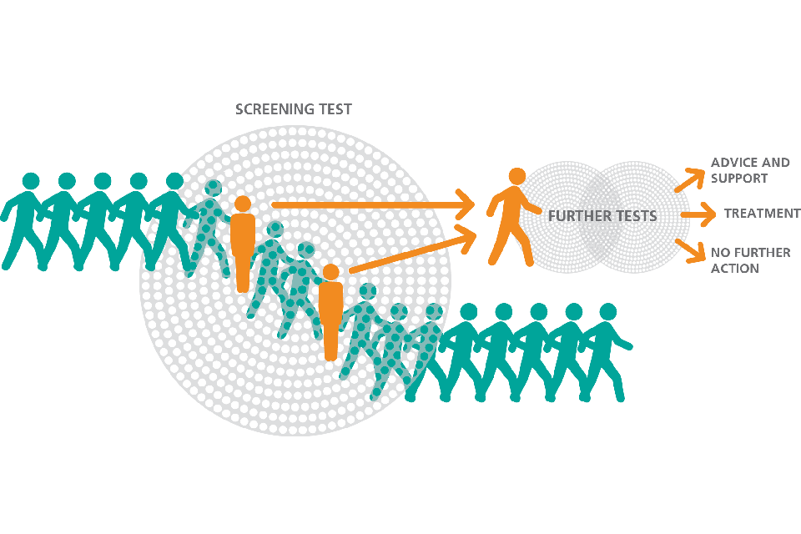
Characteristics of Screening Programs
Brief or limited evaluation of a group of individuals presumed to be normal
Results must be communicated
Follow-up on referrals for those “at risk” key component of screening
Follow-up continued until problem is resolved
Vision Screening Guidelines Page 5
Notes:
What does a vision screening program “look like” ?

Slide 5
Screening Schedule
Grade | Screen | Type of Screening
All students new to district | Recommended | Age Appropriate
K | Recommended | Near & Distance Acuity, Random Dot E
1st | Recommended | Near & Distance Acuity, Random Dot E
2nd | Recommended | Near & Distance Acuity, Random Dot E
3rd | Recommended | Near & Distance Acuity, Random Dot E
Every other year after 3rd grade | Recommended as time permits | Near & Distance Acuity
Vision Screening Guidelines Page 6
Notes:
Annually, the Missouri School Health guidelines recommend that all students new to your district are screened, all K, 1st, 2nd, and 3rd graders are screened, and every other year after 3rd grade as time permits. Near & distance acuity including RDE is recommended up to 3rd grade, and after 3rd grade RDE is no longer recommended. This information is located in the manual - Guidelines for Vision Screening in Missouri Schools.

Slide 6
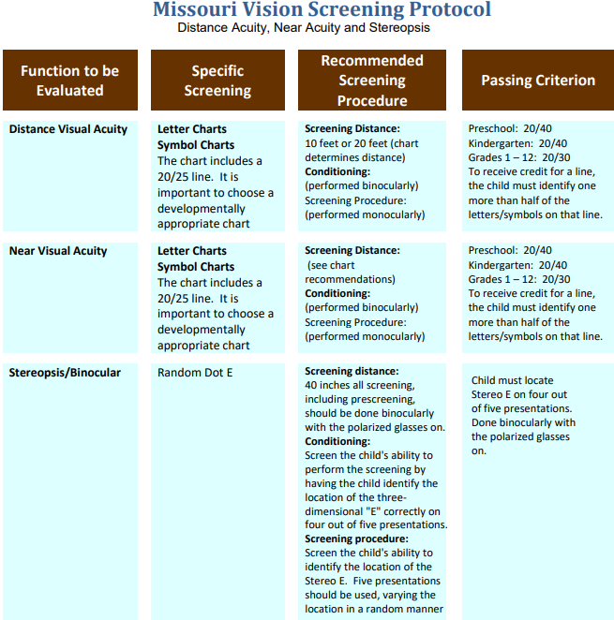
Notes:
Page 14 of the Vision Screening Guidelines outlines the Missouri Vision Screening Protocol including:

Slide 7
Visual Acuity
Notes:
Visual acuity refers to the sharpness of one’s eyesight. The size of all letters in a row is smaller than the row above. Beside each row is a fraction. The top half of the fraction (numerator) stands for how many feet the person is standing from the chart (usually 20 feet). The bottom half of the fraction (denominator) shows how far away a person with normal visual acuity can stand from the chart and still read the symbol. The 20/20 line is the standard for normal vision. A screening result of 20/100 means that the smallest line the person can read at 20 feet could be read by a person with normal vision at 100 feet. Numerator – distance from the subject to the chart, e.g., 20 feet • Denominator – distance a person with normal vision can see the chart, e.g., 100 feet • Example: 20/40 – At 20 feet, the eye sees at a 20 foot distance what a normal eye sees at 40 feet. Visual

Slide 8
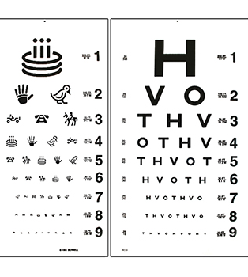
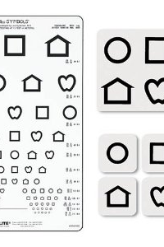
Examples of Vision Charts
Notes:
Vision screening standards indicate:
Screening at 10-20 feet (10 ft recommended for younger children).
Distance should be measured and child’s heels should be on measured line.
If wearing glasses screen with glasses on.
Vision testing machines (such as Titmus) are not recommended.
If the student fails the screening, rescreen at least once within a month before referral.
**Preschool and non-verbal students may require functional screening to determine visual ability. Refer to vision screening guidelines, screening Infants and Toddlers section.

Slide 9
Distance Visual Acuity Screening
Purpose
Screen for clearness of vision when looking in the distance
Detects
Myopia (nearsightedness)
Amblyopia (weakness of sight, lazy eye)
Astigmatism (blurred vision)
Equipment
Distance chart for 10 or 20 feet (should include 20/25 line)
Choose according to student’s developmental level
HOTV, Snellen, Sloan, Tumbling E, LEA Symbol, Lighthouse
Occluder (e.g., paper cup, paper patch, palm of hand with tissue)
Antibacterial wipes
(Vision Screening Guidelines pg 7)
Vision Screening Manual Page 5
Notes:
The next few slides review the vision screening process for distance, near, and random dot E.

Slide 10
Location
Quiet with no distractions
Well lit and free from glare
Suggestions
Room 5 feet longer than distance for screening tool
Minimum of 8-10 feet between stations if multiple stations
Setup
Chart at student’s eye level
May be seated or standing
Mark off a 10-20 feet distance with tape (distance depends on chart)
Position heels or back legs of chair on tape
Eyes should be in direct line above tape
Vision Screening Manual Page 6

Slide 11
Distance Visual Acuity Screening
Procedure
Orient student to the screening
Demonstrate use of occluder
Ask if student wears glasses. If yes, screening should be done with glasses on (be sure to mark the form)
Watch carefully that student is not peeking, tilting head, squinting or leaning head or torso forward
Begin by screening right eye with left eye occluded
Instruct to keep both eyes open and read the selected letter or line of letters with the uncovered eye.
Begin at 20/50 line and move down to 20/20 line

Slide 12
Procedure (cont.)
Move upward if student unable to read 20/50 lineProcedure (cont.)
Move upward if student unable to read 20/50 line
Do not use marking device as pointer to avoid leaving distracting marks on chart
Student must identify or match one more than half of the letters/symbols on a line
Record results including the line number for the last line read correctly with each eye
Repeat procedure for left eye
If student is unsuccessful, he or she should be rescreened within 14-21 days
as pointer to avoid leaving distracting marks on chart
Student must identify or match one more than half of the letters/symbols on a line
Record results including the line number for the last line read correctly with each eye
Repeat procedure for left eye
If student is unsuccessful, he or she should be rescreened within 14-21 days

Slide 13
Distance Visual Acuity Referral Criteria A failed screening followed by a failed re-screening should be referred for further evaluation
Grade | Criteria
Kindergarten | Each eye must see at least the 20/40 line.
1st – 12th grade | Each eye must see at least the 20/30 line.
Vision Screening Manual page 9

Slide 14
Distance Visual Acuity Referral Criteria Important Exception
One Eye | Other Eye | Results
20/20 | 20/20 | Pass
20/25 | 20/25 | Pass
20/30 | 20/30 | Pass
20/20 | 20/25 | Pass
20/20 | 20/30 | Refer – 2 line difference
Refer if there is a two-line difference

Slide 15
Near Visual Acuity Screening
Purpose
Screen for near visual acuity
Detect excessive hyperopia (farsightedness)
Equipment
Near vision chart chosen according to student’s developmental level (should include 20/25 line)
Occluder (e.g., paper cup, paper patch, palm of hand with tissue)
Antibacterial wipes
Location
Quiet and no distractions
Well lit and free from glare
Suggest--minimum of 8-10” between stations if multiple stations
Vision Screening Manual Page 10

Slide 16
Near Visual Acuity Screening
Procedure
Orient student to the screening
Demonstrate use of occlude, chart should be 16-18 inches
Ask if student wears glasses. If yes, screening should be done with glasses on (be sure to mark the form)
Watch carefully that student is not peeking, tilting head, squinting or leaning head or torso forward
Begin by screening right eye with left eye occluded
Instruct to keep both eyes open and read the selected letter or line of letters with the uncovered eye.
Begin at 20/50 line and move down to 20/20 line
Ask the student to name or read the letter or symbols on each line as directed.

Slide 17
Near Visual Acuity Screening
Procedure (cont.)
Move upward if student unable to read 20/50 line
Do not use marking device as pointer to avoid leaving distracting marks on chart
Student must identify or match one more than half of the letters/symbols on a line
Record results including the line number for the last line read correctly with each eye
Repeat procedure for left eye
If student is unsuccessful, he or she should be rescreened within 14-21 days

Slide 18
Near Visual Acuity Referral Criteria
Grade | Criteria
Kindergarten | Each eye must see at least the 20/40 line.
1st – 12th grade | Each eye must see at least the 20/30 line.
A failed screening followed by a failed re-screening should be referred for further evaluation
Vision Screening Guidelines Page 11

Slide 19
Near Visual Acuity Referral Criteria
One Eye | Other Eye | Results
20/20 | 20/20 | Pass
20/25 | 20/25 | Pass
20/30 | 20/30 | Pass
20/20 | 20/25 | Pass
20/20 | 20/30 | Refer – 2 line difference
IMPORTANT EXCEPTION
Refer if there is a two-line difference

Slide 20
Binocularity/Stereoscopic Vision Screening
What is Binocular Vision?
Includes ocular alignment and stereo acuity
Screening determines how well eyes function together
Purpose of Screening
to determine if student has adequate binocularity
Equipment
Random Dot (RDE) Stereotest Kit
Antibacterial wipes
Vision Screening Guidelines Page 11

Slide 21
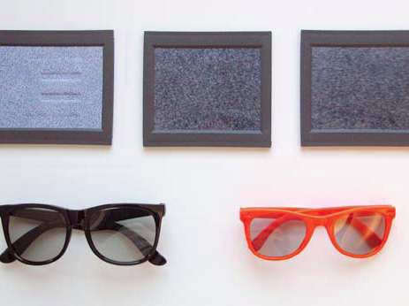
Random Dot E Kit Equipment

Slide 22
Random Dot E
With glasses in place, children with good alignment and normal binocular vision will be able to see the stereo “E” in 3-dimensions. (page 11)

Slide 23
Random Dot E
Location and Setup
Make sure that the test distance between the student and the cards is carefully measured at 40 inches.
Make sure that there is bright room lighting.
Procedure
Have student put on stereo glasses.
If the student wears glasses, the stereo glasses should be placed over the student’s own glasses. (Indicate on form)
Be sure the student keeps head straight when viewing slides
Vision Screening Guidelines Page 11

Slide 24
Random Dot E
Hold model E demonstration plate at a distance of a 40 inches in front of student.
Point to the “E” and say to the student, “Tell me what you see.”

Slide 25
Random Dot E
Pick up the blank test plate and hold it next to the demonstration plate.
Ask the student to point to the plate with the raised, embossed “E”.

Slide 26
Random Dot E
Shuffle the plates behind your back and repeat the procedure 4 more times, holding the plates side by side or above and below each other. Vary the position.

Slide 27
Random Dot E
Replace the Model E slide with the Raised/Recessed Stereo slide when you determine that the student understands the procedure
Repeat the procedure
Student passes the stereo screening if he/she correctly identifies the location of the stereo E on at least 4 of the 5 presentations.

Slide 28
Vision Screening Demonstration video
Notes:
To demonstrate these procedures, I would like to show a video created by the Missouri Children’s Vision Commission.
I have this saved on a flash drive.

Slide 29
Re-Screening Guidelines
Indicated for any student failing any part of the initial screening (distance, near or binocularity)
Eliminates students who failed initial screening due to factors such as fatigue, illness, anxiety, misunderstanding or distractions
Should be done within 14-21 days after initial screening
Rescreening procedures are the same as initial screening procedure
Page 15

Slide 30
ReReferrals
Indicated if student fails any portion of the rescreening
Notify parent/guardian in person or by phone prior to sending written referral
Written referral should be sent to the parent/guardian within one week after the rescreening
Important to notify classroom teach if referral sent so that classroom accommodations can be implemented
Vison Screening Guidelines page 15 Manual Page 15

Slide 31
Follow-Up and Tracking Guidelines
Most important component of any screening
Tracking system
Assures students referred receive appropriate treatment/services
Follow-up with phone call if no information about the referral received after 3-4 weeks
Continue to contact parent/guardian periodically until notified of disposition of referral
Important for nurse to be familiar with community resources for those needing financial assistance
Document all aspects of process in health record
Vision Screening Guidelines Pages 15-16
Notes:
Referral Tracking System Sample pg 40, School Vision Referral Form pg 41

Slide 32
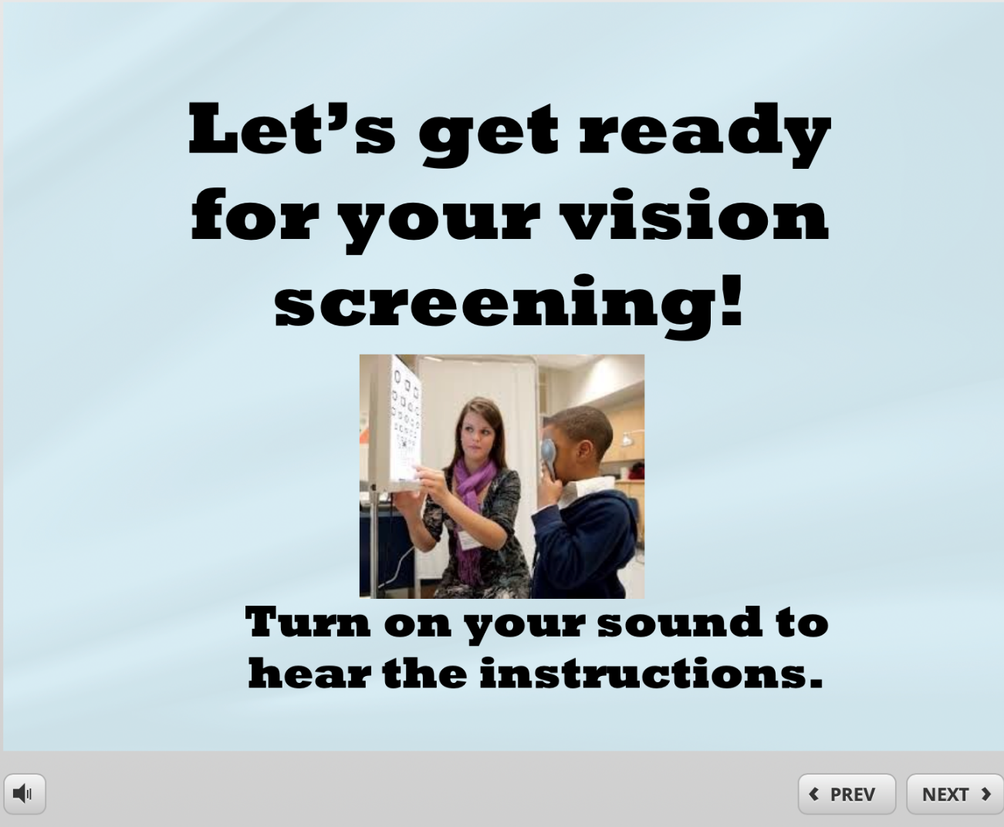
Preparing Students for Vision Screening Resource
Notes:
https://ccox.sites.truman.edu/2018/01/26/vision-screening-prep/

Slide 33
Missouri School Vision Screening Guidelines – instrument-based screenings are not recommended. (examples: Titmus, Stereoptic, SPOT, photoscreeners)
If you are using an outside agency for screenings, be sure to review your board policy regarding screenings and volunteers. Volunteers may be required to have a background check. Using outside agencies for your screening programs may be considered conflict of interest.

Slide 34
References
DHSS Vision Screening Training PowerPoint https://health.mo.gov/living/families/schoolhealth/pdf/VisionScreeningTraining.pdf
DHSS Vision Screening Guidelines https://health.mo.gov/living/families/schoolhealth/pdf/GuidelinesVisionScreening.pdf
American Association for Pediatric Ophthalmology and Strabismus http://aapos.org

Slide 35
QUESTIONS?
Stacey Whitney MSN, RN, NCSN
staceywhitney@therapylog.com
417-437-8961

